Slide 1
Site Selection for Kelp Farms
Optimizing and informing site selection for Kelp Farms including prediction of yearly yield.
David Jablonski

Slide 2
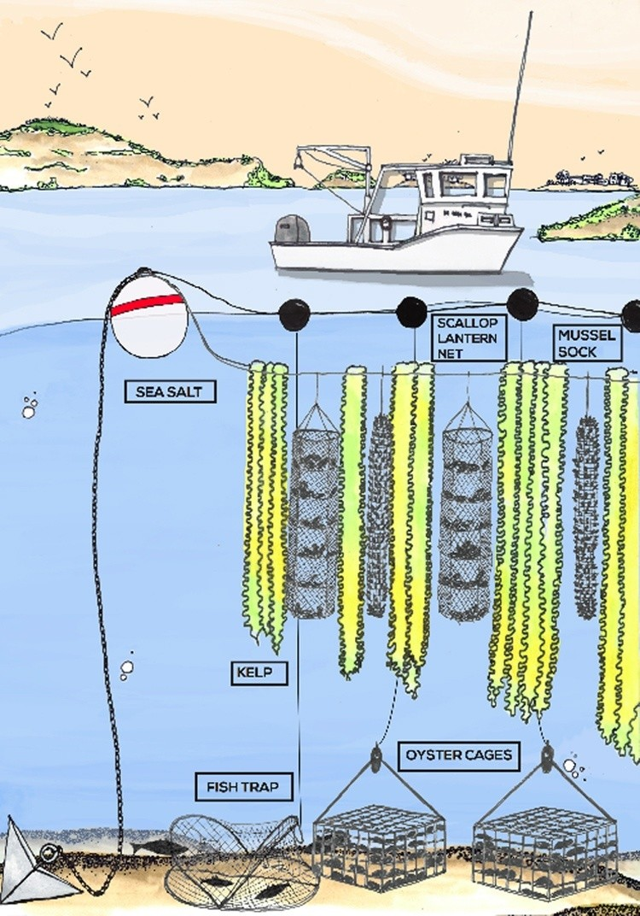
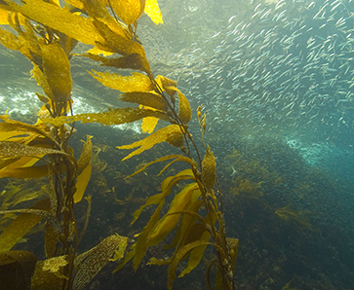
The Problem
Kelp farming can be a helpful alternative to bolster the food supply.
Kelp farms can grow mussels and oysters using a technique known as vertical or 3-D farming – using the water column to grow a mix of seaweed and shellfish – to get the most out of their relatively small operations.
Roughly 25% of CO2 in the atmosphere is being absorbed into oceans which turns the ocean more acidic which can be harmful to sea life.
Site selection has two major parts, state leasing requirements and having an ideal site for growth and access. The Site Selection and State Leasing and permitting processes are currently long and very onerous and only started after a farmer selects a location. By using machine learning methods LandSat images and NOAA coastal charts, states could identify prime kelp farming locations and open up leasing options ahead of demand to help foster this incredible eco-friendly and sustainable food source.

Slide 3
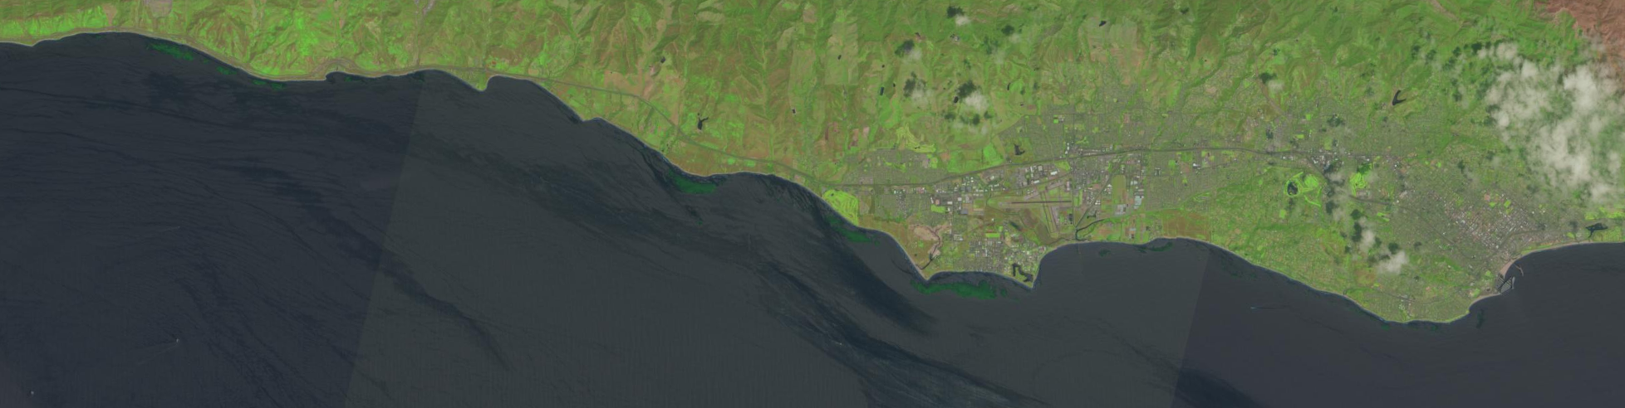
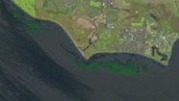
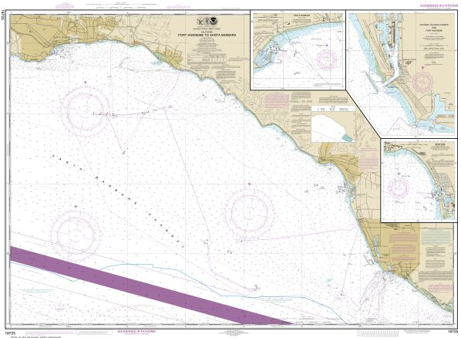
The Data
Santa Barbara Coastal - Long Term Ecological Research – Extensive research and data on the health and growth patterns of kelp
Free LandSat images – From Open Nasa to identify current kelp locations
Office of Coast Survey - NOAA Coastal Charts – to identify possible kelp farm locations

Slide 4
Possible data science techniques:
Large-scale web scraping – Automate LandSat image collection
NLP – reading depth values on the Coastal Charts
Image Recognition – Machine Learning for Vegetation (kelp)
D3/Custom Visualization – Highlight boxes on coastal map of possible Kelp farm site locations
Related research/products:
Kelp Farming Manual – best practices for Kelp Farming in Maine

Slide 5
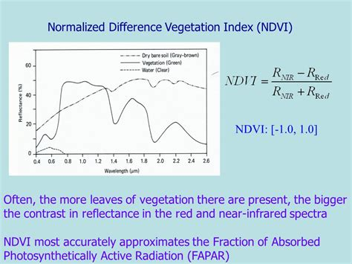
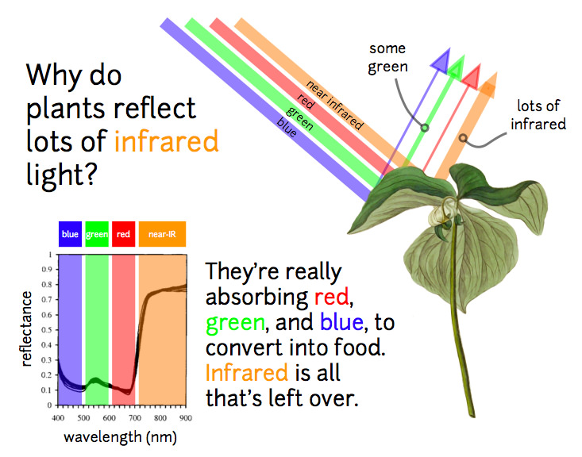
If you mask the land, the vegetation on land (seen above) will not be included in the kelp measurements. Then using NDVI the kelp will stand out. Even is the vegetation is “other” grasses or ocean vegetation, it will still probably be good for growing kelp.

Slide 6
Best Kelp Farming conditions
Things to look for in a site:
Adequate current (one to two knots during peak ebb and flood).
Usually the water is between 30 (can be deeper but lines need to be moored to the ocean floor) and 18 feet. (A depth in excess of 18 feet at mean low water (MLW). This will reduce the chance of kelp touching bottom, helping to keep it clean and reducing the amount of biofouling on long lines.)
Not in shipping lanes but close enough for the kelp farmers to get to. (this will be a judgement call)
Not in an area of essential habitat or endangered species and an appropriate distance from protected shore birds. In Maine this is 1,000 feet. It is best to pick sites that are at least 1,320 feet (¼ mile) away.
No significant flora and fauna, such as eelgrass, on the bottom. Another reason why mud bottoms are preferred.
Is at least 1,000 feet from any state- or municipally-owned pier, beach, etc. ( this is for Maine but probably for other states)

